Slide 1
Worksheet
Primary 6

Slide 2


Resources Circulation in Hong Kong
Student Worksheet
Name
Short questions
1. Suggest a way to practice the 4R principles of waste reduction in daily life.
Reduce
Reuse
Replace
Recycle

Slide 3








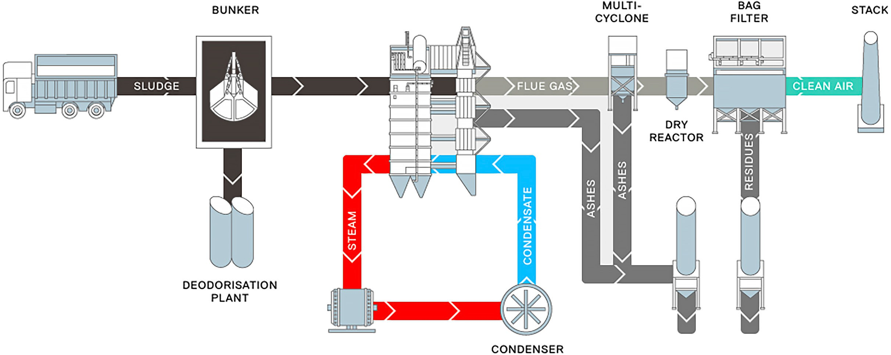

2. Write down the correct sequence for clean recycling for each recyclable
Steps for Clean
Recycling
Separate recyclables and non-recyclables
Separate different components
Drain liquid
Rinse
thoroughly
Empty the container
Cut and flatten
Remove
impurities
Recyclable
Steps for clean recycling
Colour of recycling bin
Paper
Metals
Beverage cartons
Glass bottles
Plastic bottles
Food waste
Fill in the blanks: Fill in the blanks as appropriate.
Incineration
Food waste reception
Flue gas treatment
Steam turbine generator
Power generation
Sludge reception
Ash and residue handling
Condenser
Source: T·PARK

Slide 4

Reflective questions
1. Suggest one method to reduce waste at source.
2. Name one example of upcycling.

Slide 5
Extended Activity Kit
Primary 6

Slide 6
Resources Circulation in Hong Kong
Extended Activity
Resources Circulation in Hong Kong
Log Sheet
Used items collated | Plastics (kg) | Metals (kg) | Paper (kg) | Others (pcs / kg)
Group 1
Group 2
Group 3
Group 4
Group 5
Total
Verification teacher’s signature

Slide 7
Resources Circulation in Hong Kong
Extended Activity
Resources Circulation in Hong Kong
Marking Scheme
Assessment Criteria | Scoring indicators |  |  |  |  | Score
 | 5 | 4 | 3 | 2 | 1
Amount of used items collected | High quantity with wide diversity of used items collected | Relatively high quantity, moderate diversity of used items collected | Moderate quantity, relatively low diversity of used items collected | Low quantity, little diversity of used items collected | Minimal or no used items collected
Elaboration of design concept | Clear, creative design concept, high practicality | Generally clear, creative design concept, relatively high practicality | Average explanation, ordinary design concept, average practicality | Unclear explanation, lack of creativity and design concept, low practicality | No explanation or insufficient explanation, not practical
Visual appeal | With very good aesthetically pleasing, and look artistic | With good aesthetically pleasing | Average design | Monotonous design | Unattractive or chaotic
Total Score

Slide 8

Resources Circulation in Hong Kong
Extended Activity
Name
Green Classroom Design Worksheet
 | Used item | Quantity | Used item | Quantity
List of used items
Illustration of transformed
items
Design
description
(50-100 words)
Position of decoration
Tool
Quantity
Tool
Quantity
List of tools

Slide 9
“Recources Circulation in Hong Kong” Extended Activity 3:
School Notice XXX Primary School
Activity Notice on P.6 General Studies Visit to T·PARK
Dear Parents / Guardians,
To comply with the curriculum of General Studies of Primary 6, a visit to T·PARK will be arranged for Primary 6 students. The details are as follows:
Date | : | XX XX 20XX (X)
Venue | : | T·PARK (25 Nim Wan Road, Tsang Tsui, Tuen Mun)
Visiting hours | : | 9:30 a.m. – 1:30 p.m.
Transportation | : | Shuttle bus
Teacher-in-charge | : | Mr. / Miss XXX
Remarks | : | Students are required to wear school sports uniform The visit will be led by the General Studies teachers Students should bring along student worksheet and stationeries
Students are required to participate in this activity in order to comply with the curriculum of their study. If there are any special circumstances, please discuss with the General Studies teacher. Parents are required to fill in the Reply Slip and submit it to the General Studies Teacher by XX XX (X). If you have any enquiry, please contact Mr. / Miss XXX at XXXX XXXX.
Yours sincerely, Mr. / Miss XXX
Principal
XX XX 20XX
----------------------------- Reply Slip ----------------------------- (Parents please keep the above notice for reference) Reply Slip for Activity Notice on P.6 General Studies Visit to
T·PARK
To whom it may concern:
I agree to allow my child to attend the visit to T·PARK and have acknowledged the arrangements.
Student’s Name: Class: ( )
Parent / Guardian’s Name: Parent / Guardian’s Contact No.:
Parent / Guardian’s Signature:
(Please sign with a ball pen)
XX XX 20XX

Slide 10
“Resources Circulation in Hong Kong” Extended Activity 3: Activity Details List
P.6 General Studies Visit to T·PARK
Date: XX XX 20XX (X) |  | Time: 09:30-13:30
Venue: T·PARK (25 Nim Wan Road, Tsang Tsui, Tuen Mun)
Time | Events | Materials
09:30-09:40 | Roll Call | Student List
09:40-10:40 | Take shuttle bus to T·PARK | ／
10:45-12:10 | Guided Tour | ／
12:10-12:30 | Conclusion | Student Worksheet
12:30-13:30 | Return to school by shuttle bus | ／
P.6 General Studies Visit to T·PARK Student List Teacher-in-charge: Mr. / Miss XXX
No. | Student no. | Student’s name | Gender | Parent / Guardian's contact no. | Attendance
1.
2.
3.
4.
5.
6.
7.
8.
9.
10.
11.
12.
13.
14.
15.
16.
17.
18.
19.
20.
21.
22.
23.
24.
25.

Slide 11



Resources Circulation in Hong Kong
Extended Activity
Name
Student Worksheet
What was the most profound experience during the visit? (30-50 words)
What have I learnt? (30-50 words)
Briefly describe the “waste-to-energy” process adopted at T·PARK. (30-50 words)

Slide 12
“Recources Circulation in Hong Kong” Extended Activity 4:
School Notice XXX Primary School
Activity Notice on P.6 General Studies Visit to WEEE·PARK Dear Parents / Guardians,
To comply with the curriculum of General Studies of Primary 6, a visit to WEEE·PARK will be arranged for Primary 6 students. The details are as follows:
Date | : | XX XX 20XX (X)
Venue | : | WEEE·PARK (Lots P2-P4 of EcoPark, 133 Lung Mun Road, Tuen Mun Area 38)
Visiting hours | : | 9:30 a.m. – 1:30 p.m.
Transportation | : | Shuttle bus
Teacher-in-charge | : | Mr. / Miss XXX
Remarks | : | Students are required to wear school sports uniform The visit will be led by the General Studies teachers Students should bring along student worksheet and stationeries
Students are required to participate in this activity in order to comply with the curriculum of their study. If there are any special circumstances, please discuss with the General Studies teacher. Parents are required to fill in the Reply Slip and submit it to the General Studies Teacher by XX XX (X). If you have any enquiry, please contact Mr. / Miss XXX at XXXX XXXX.
Yours sincerely, Mr. / Miss XXX
Principal
XX XX 20XX
----------------------------- Reply Slip ----------------------------- (Parents please keep the above notice for reference) Reply Slip for Activity Notice on P.6 General Studies Visit to
WEEE·PARK
To whom it may concern:
I agree to allow my child to attend the visit to WEEE·PARK and have acknowledged the arrangements.
Student’s Name: Class: ( )
Parent / Guardian’s Name: Parent / Guardian’s Contact No.:
Parent / Guardian’s Signature:
(Please sign with a ball pen)
XX XX 20XX

Slide 13
“Resources Circulation in Hong Kong” Extended Activity 4: Activity Details List
P.6 General Studies Visit to WEEE·PARK
Date: XX XX 20XX (X) |  | Time: 09:30-13:30
Venue: WEEE·PARK (Lots P2-P4 of EcoPark, 133 Lung Mun Road, Tuen Mun Area 38)
Time | Events | Materials
09:30-09:40 | Roll Call | Student List
09:40-10:40 | Take shuttle bus to WEEE·PARK | ／
10:45-12:00 | Guided Tour | ／
12:00-12:30 | Conclusion | Student Worksheet
12:30-13:30 | Return to school by shuttle bus | ／
P.6 General Studies Visit to WEEE·PARK Student List Teacher-in-charge: Mr. / Miss XXX
No. | Student no. | Student’s name | Gender | Parent / Guardian's contact no. | Attendance
1.
2.
3.
4.
5.
6.
7.
8.
9.
10.
11.
12.
13.
14.
15.
16.
17.
18.
19.
20.
21.
22.
23.
24.
25.

Slide 14

Resources Circulation in Hong Kong
Extended Activity
Name
Student Worksheet
What was the most profound experience during the visit? (30-50 words)
What have I learnt? (30-50 words)
Suggest two ways to reduce the disposal of waste electrical and electronic equipment. (30-50 words)

